Slide 1
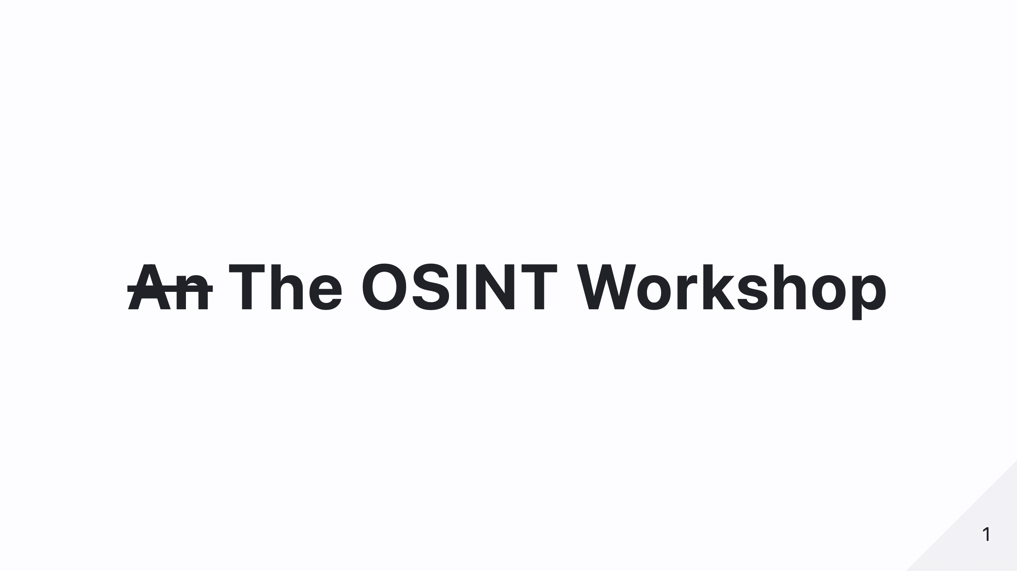
Notes:
Welcome, everyone, to The OSINT Workshop! I’m Dharmik Vivek Shinde, and today, we’re going to dive deep into the world of Open-Source Intelligence. Whether you want to enhance your security skills or just understand how much of your data is out there, this session is for you!

Slide 2

Notes:
Blank slide for QR Code

Slide 3
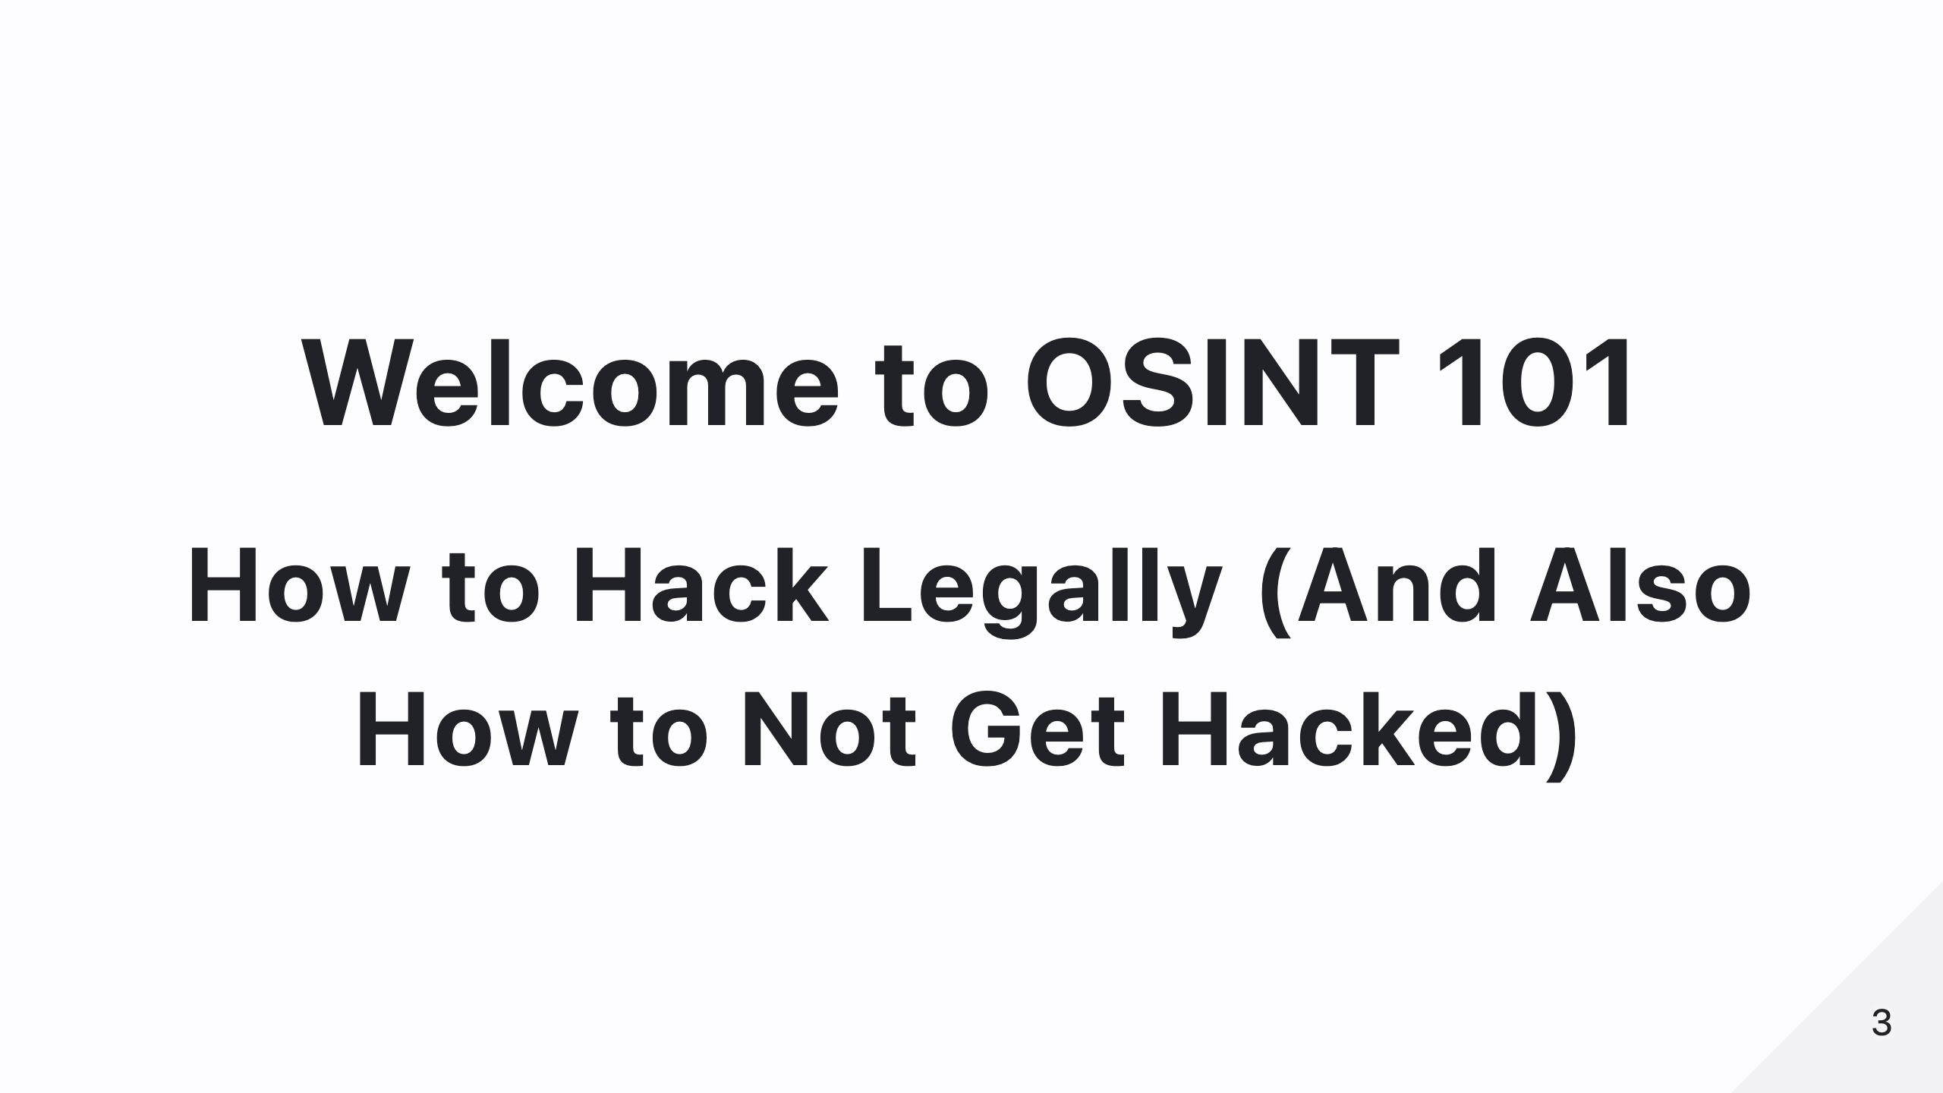
Notes:
So, what exactly is OSINT? In simple terms, it's intelligence gathering using publicly available information. Security professionals, journalists, law enforcement, and even malicious actors use OSINT daily. And today, you’ll learn how it works—and how to protect yourself from it.

Slide 4
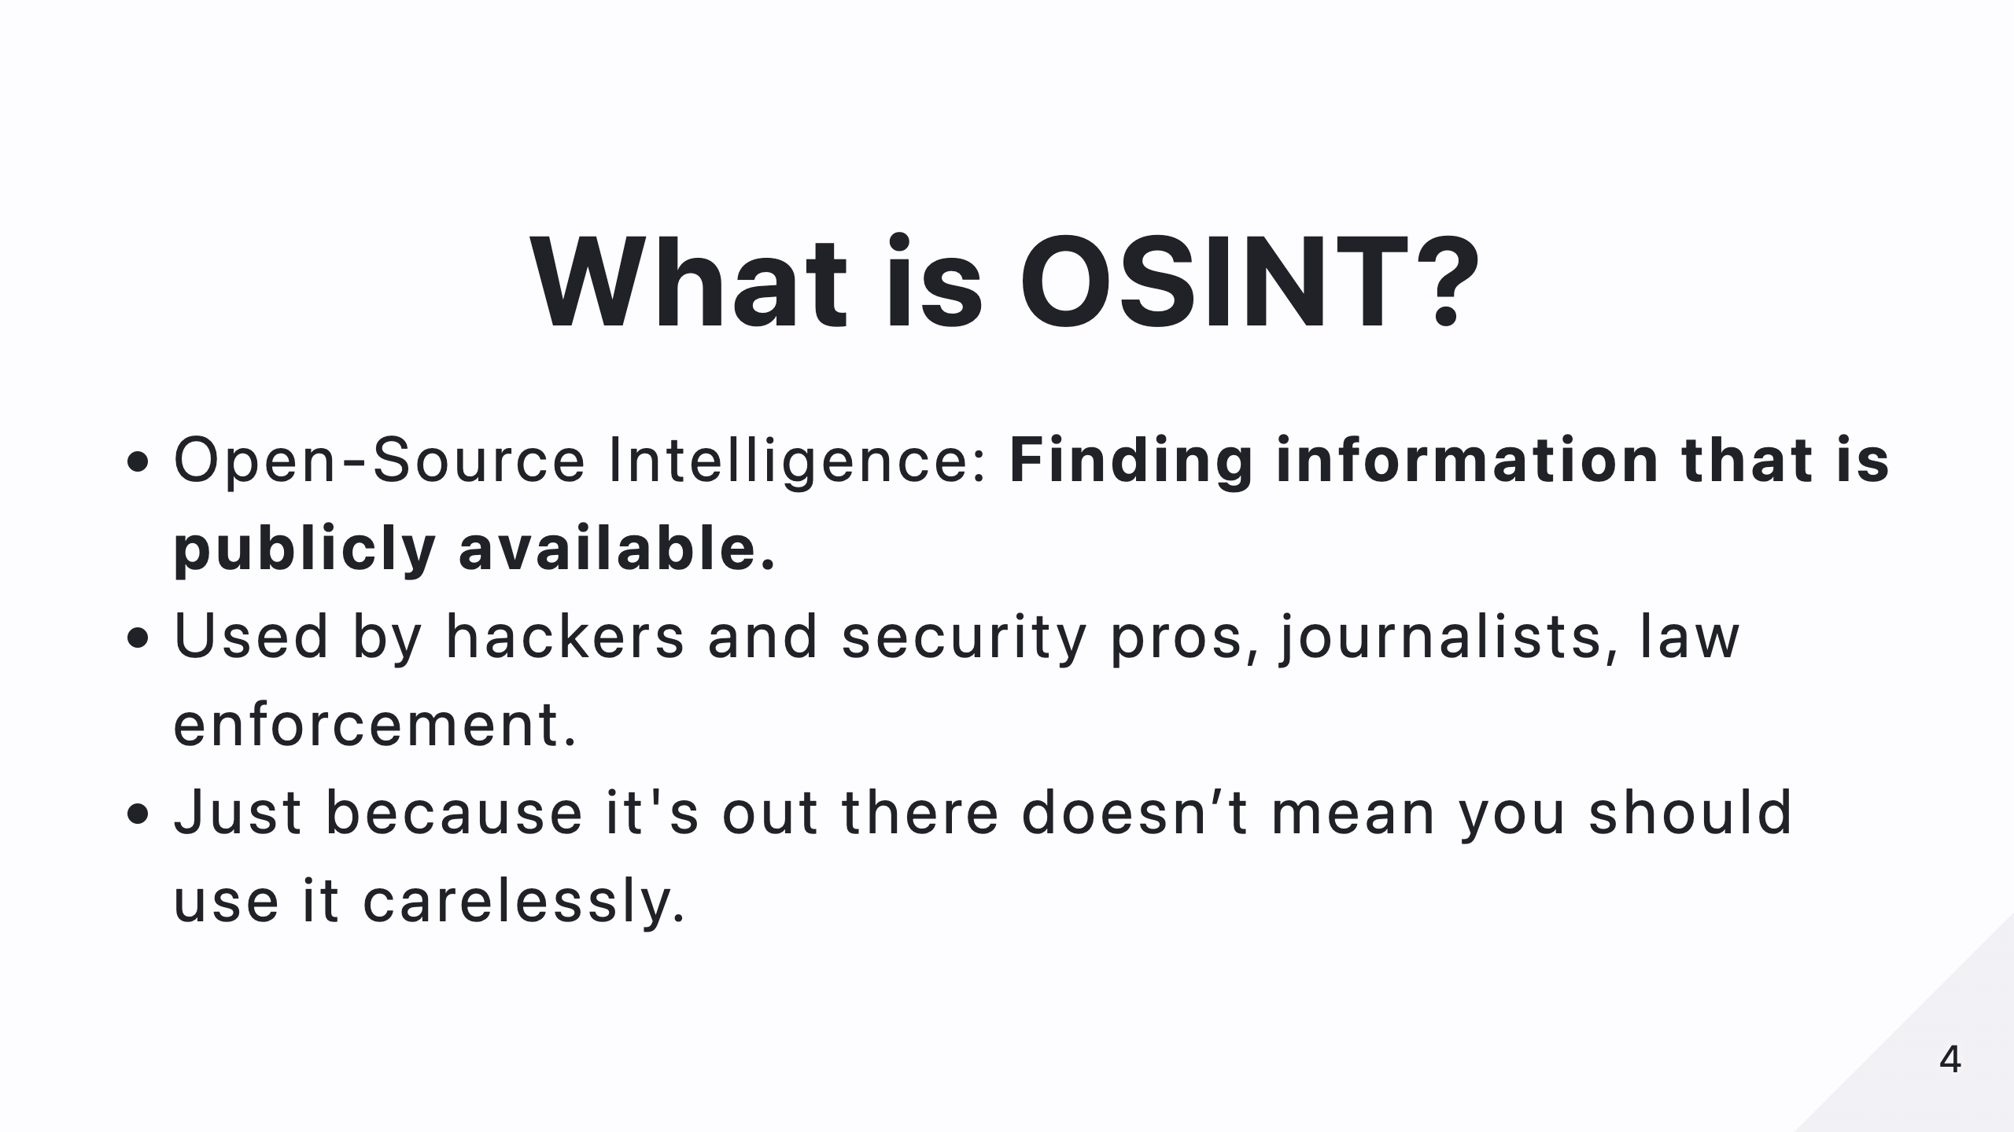
Notes:
OSINT stands for Open-Source Intelligence. It’s about finding and analyzing publicly available information. Think about the vast amount of data you and everyone else share online—it’s all out there, waiting to be discovered by someone who knows how to look.

Slide 5
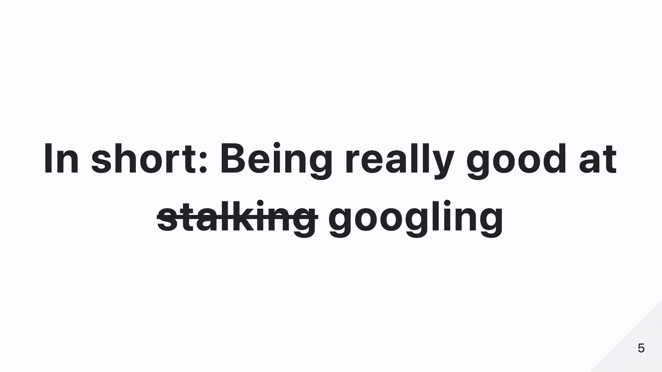
Notes:
Or, as I like to say—OSINT is just really advanced Googling. Or, if you’re less ethical, stalking. But, of course, we’re only talking about ethical use here.

Slide 6

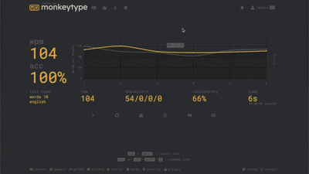
Notes:
And just like that, you fall into a rabbit hole of information... Just like when you start with one cat video and suddenly it’s 3 AM and you’re researching the history of ancient Rome.
The same thing happens in OSINT—one small clue leads to another, and before you know it, you’ve mapped out someone’s entire digital footprint.
You start with a username and end up with home addresses, relatives, and work history.
Whether you’re an investigator, journalist, or cybersecurity professional, this is a powerful skill.
But it’s also a reminder of how much we unknowingly leave behind.

Slide 7
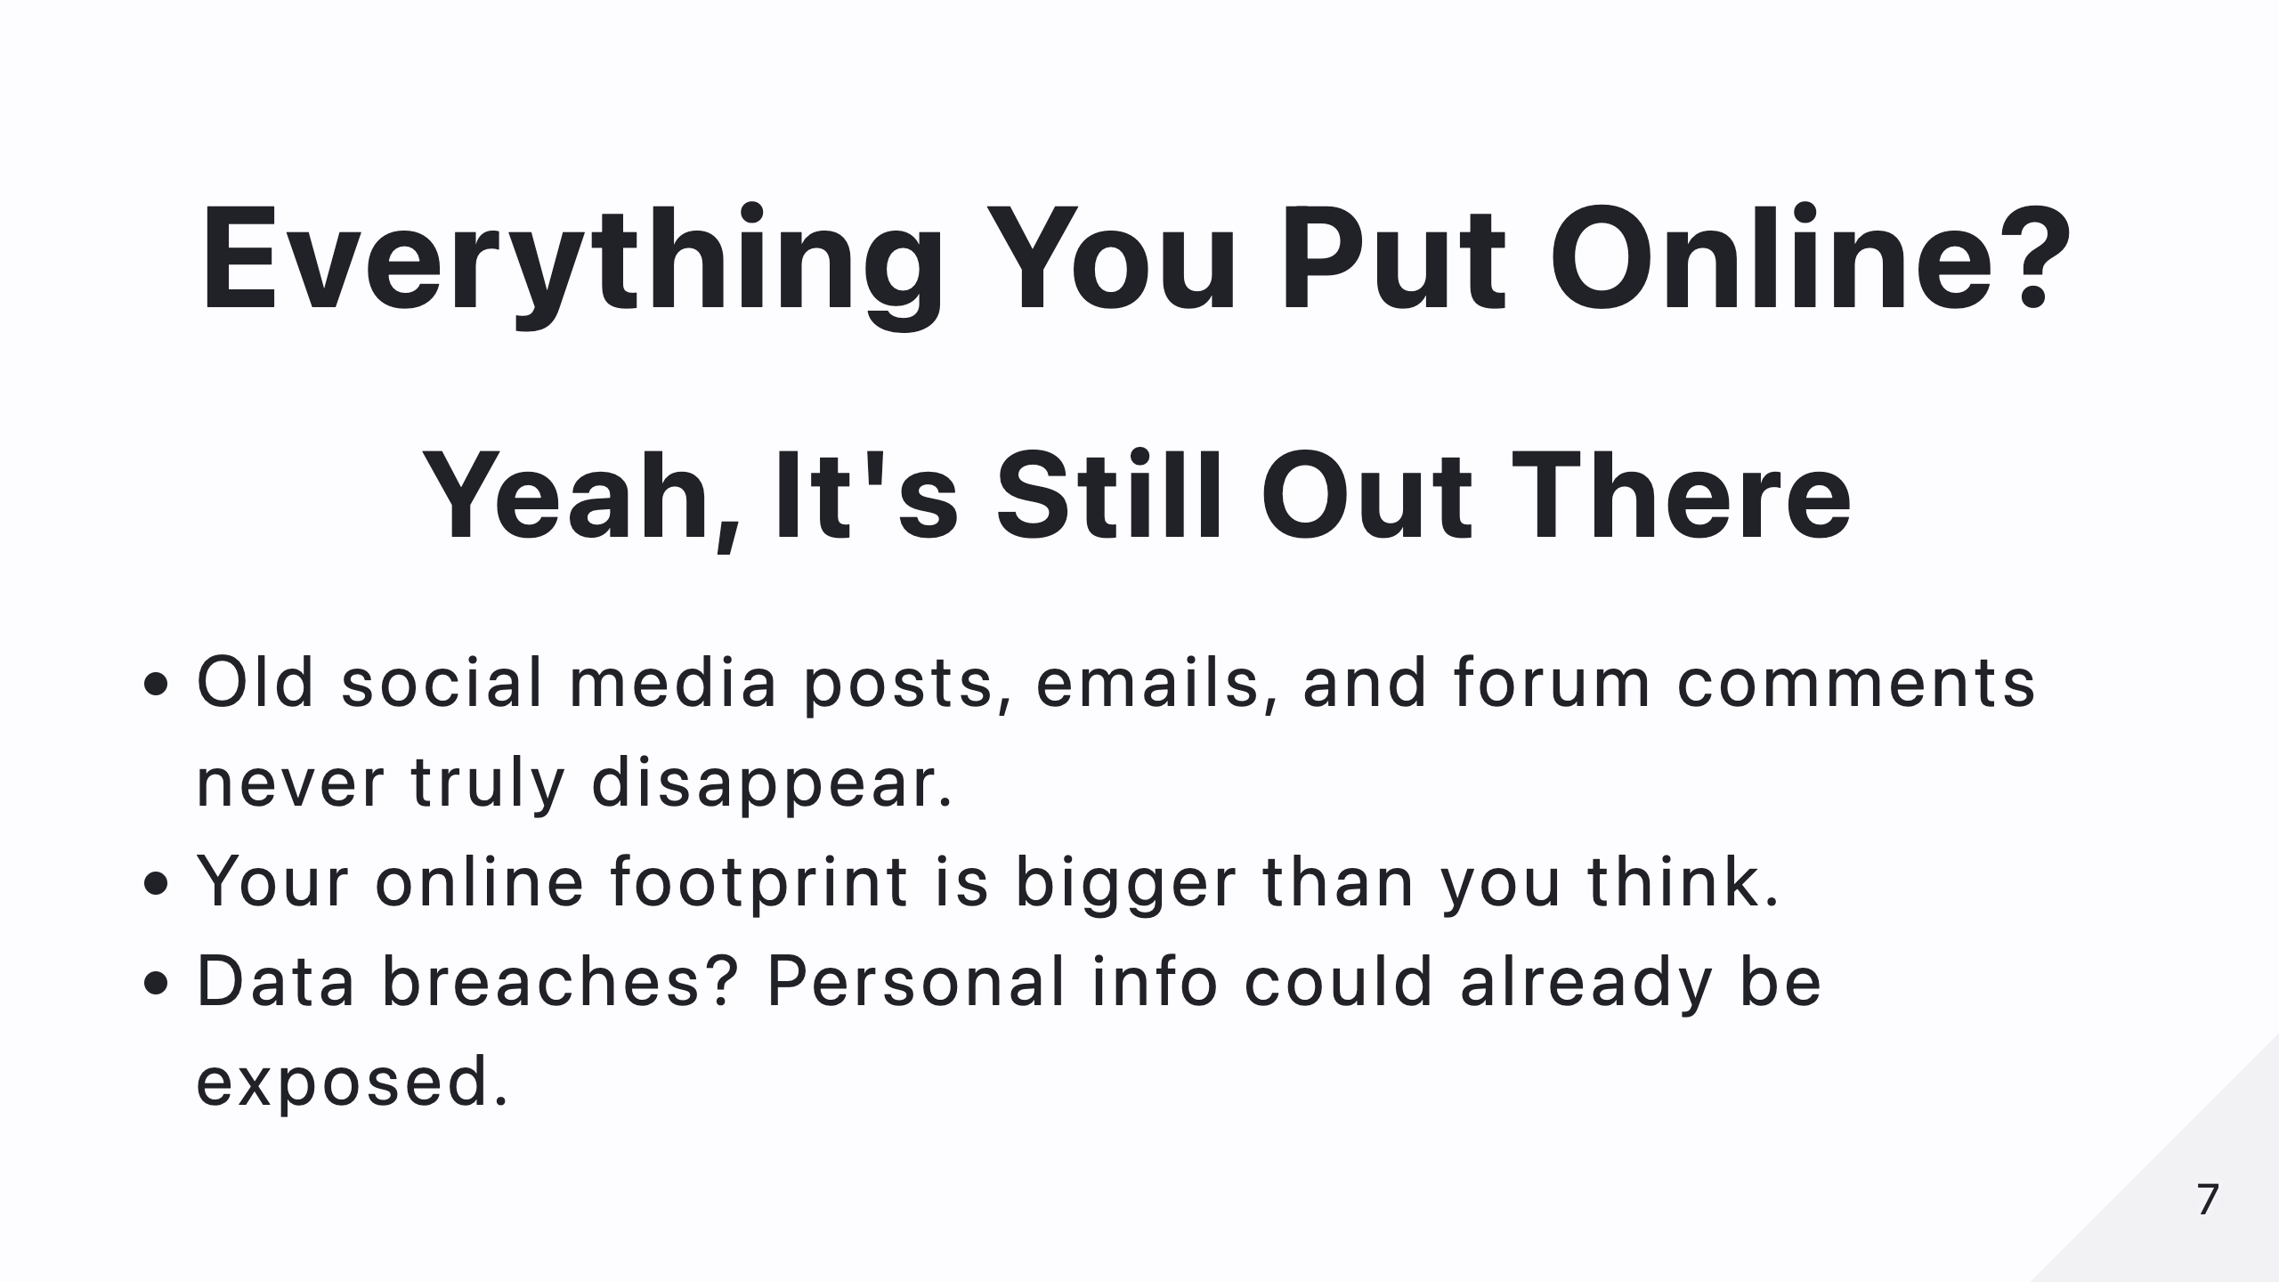
Notes:
Most people don’t realize that even when you delete something online, it doesn’t always disappear. Websites archive content, databases get leaked, and search engines keep caches of pages. Your online footprint is much bigger than you think.

Slide 8
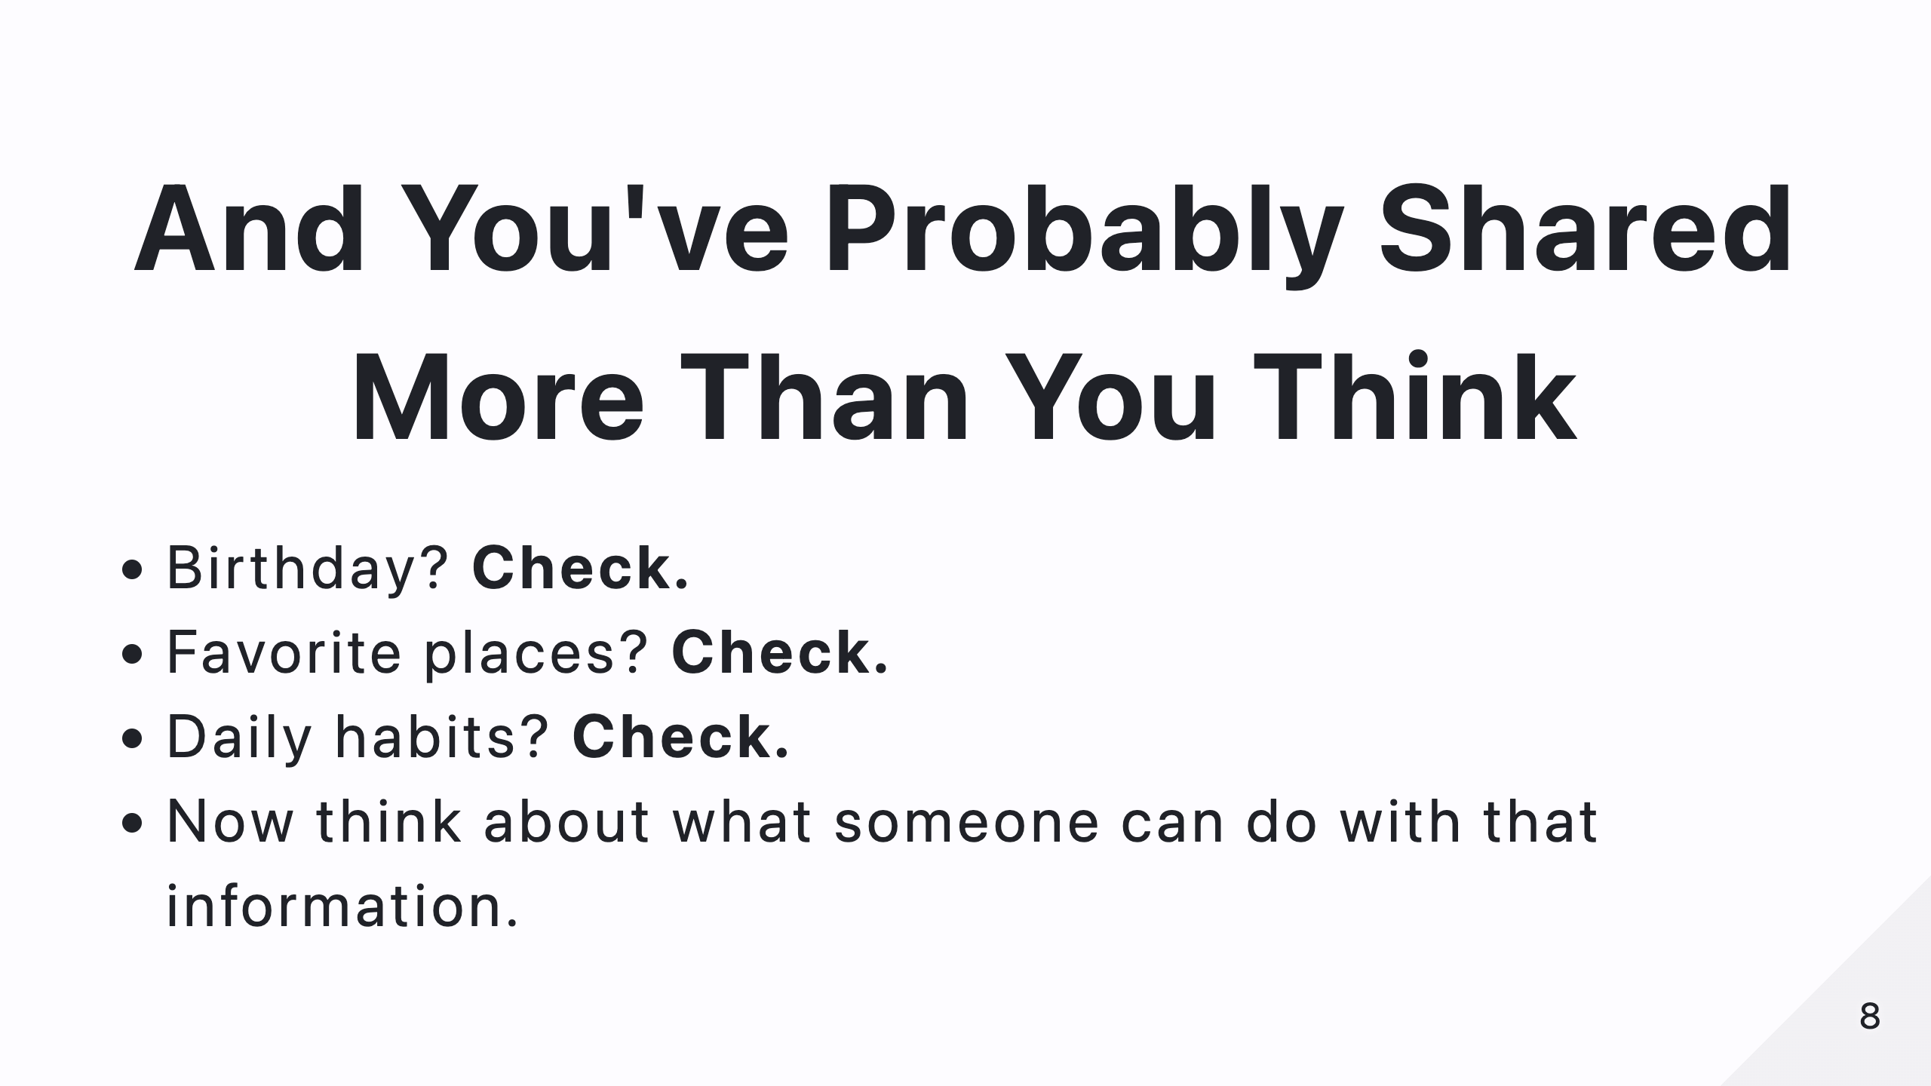
Notes:
Think about it—your birthday, your favorite food, your daily habits. Now, imagine someone piecing that information together to manipulate or scam you. That’s the power—and danger—of OSINT.

Slide 9
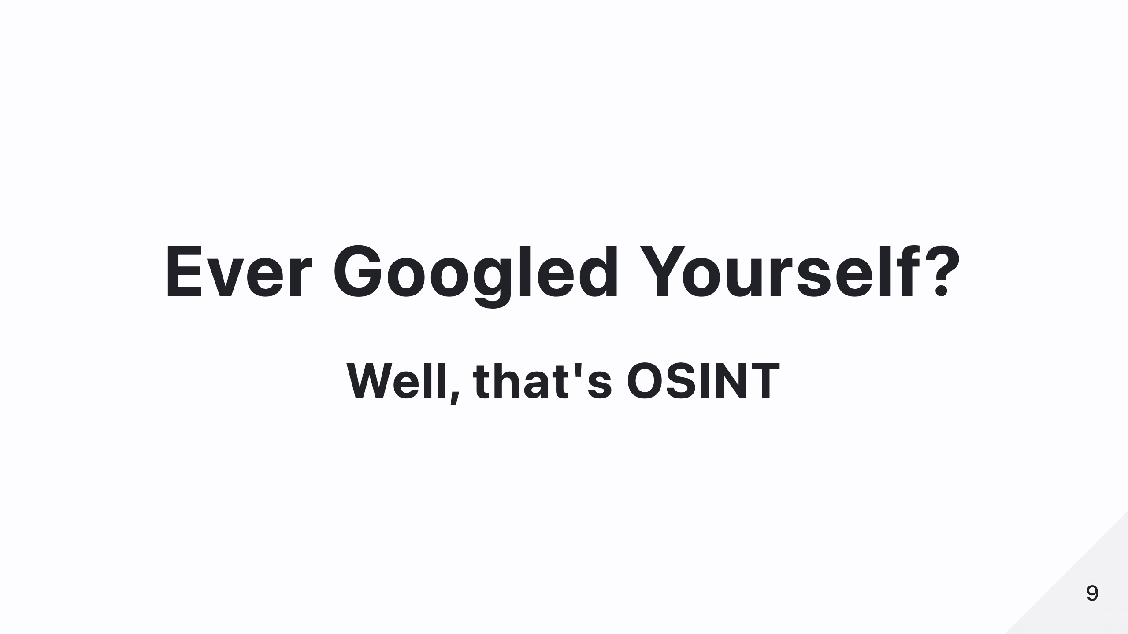
Notes:
If you’ve ever searched your own name online, congratulations! You’ve already used OSINT—on yourself.

Slide 10
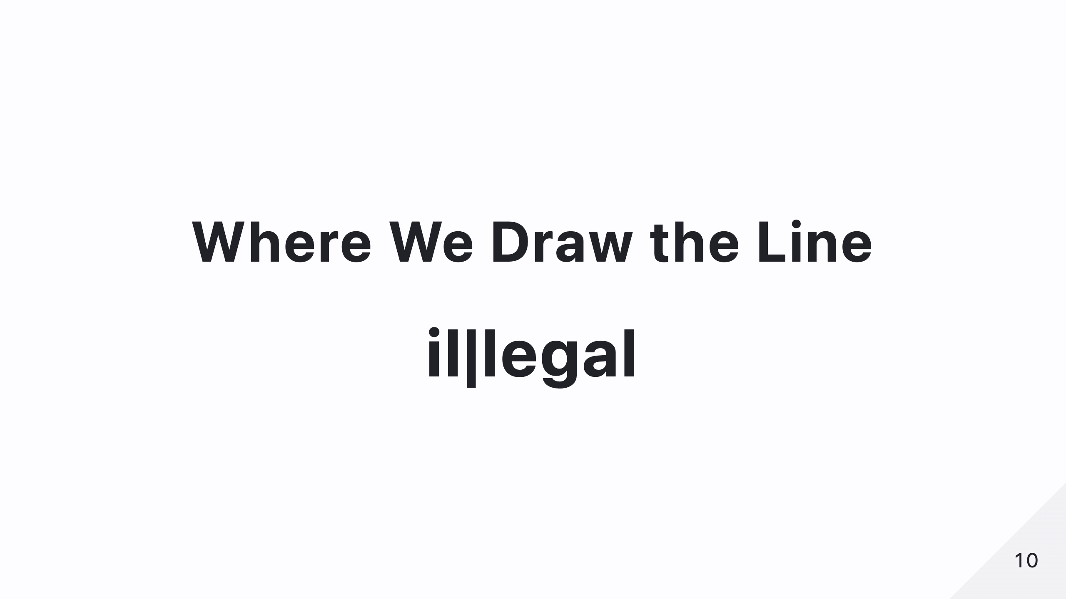
Notes:
So, where does OSINT become unethical or illegal? Here’s a quick breakdown. Google Dorking, WHOIS lookups, and analyzing public social media are fair game. But scraping non-sensitive data in bulk? That’s questionable. And accessing leaked databases or hacking? That’s straight-up illegal.

Slide 11
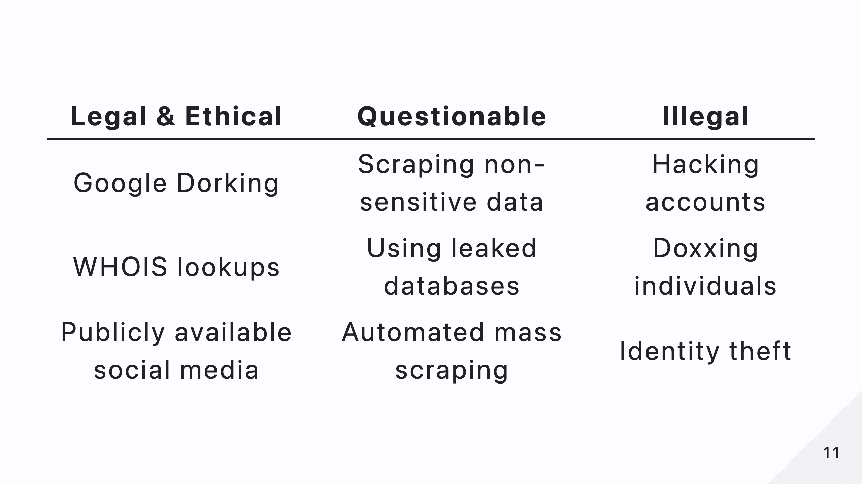
Notes:
So, where does OSINT become unethical or illegal? Here’s a quick breakdown. Google Dorking, WHOIS lookups, and analyzing public social media are fair game. But scraping non-sensitive data in bulk? That’s questionable. And accessing leaked databases or hacking? That’s straight-up illegal.

Slide 12
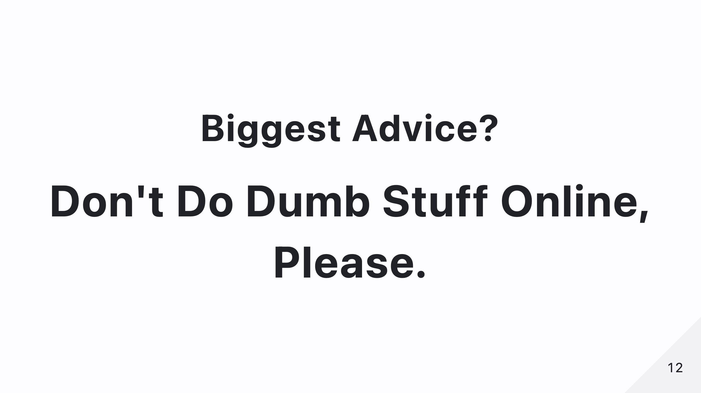
Notes:
Don’t do dumb stuff online. If it feels wrong, it probably is. And remember—just because you can find something, doesn’t mean you should use it.

Slide 13
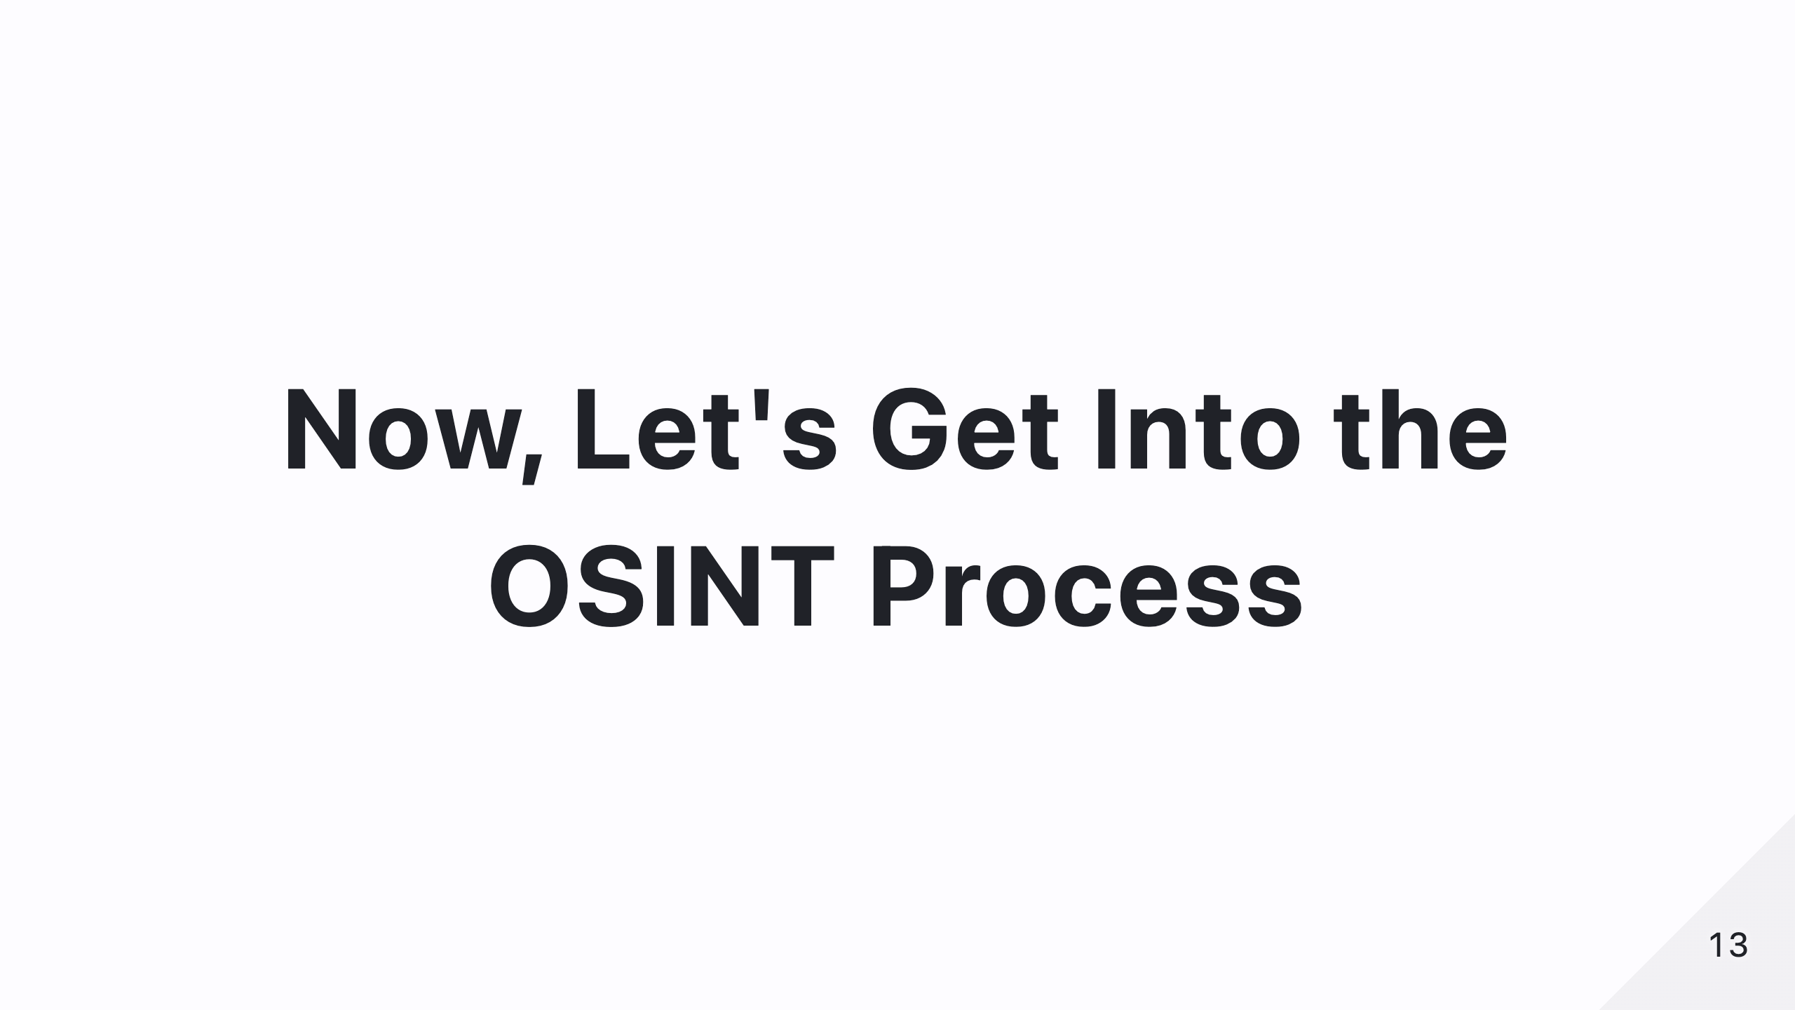
Notes:
Now that we know what OSINT is, let’s talk about the process. First, you define what you’re looking for. Then, identify where to look—Google, social media, domain registries, and more. After gathering data, you analyze it to find connections. Finally, you compile your findings into a clear report.

Slide 14
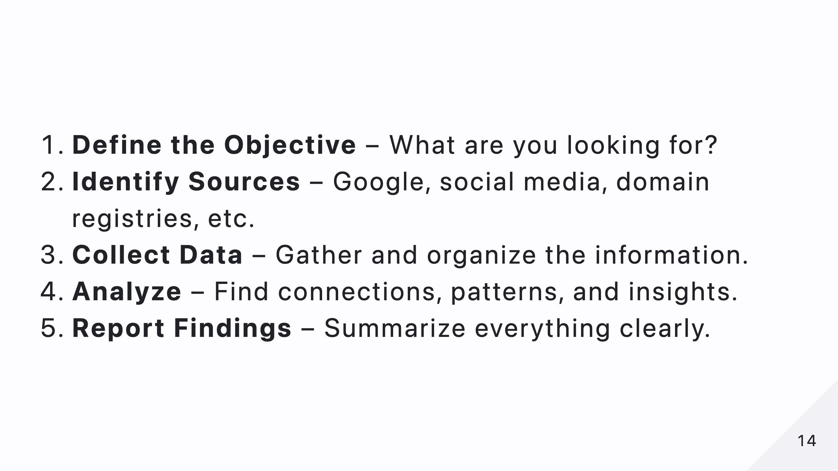
Notes:
"Now that we know what OSINT is, let’s talk about the process. First, you define what you’re looking for. Then, identify where to look—Google, social media, domain registries, and more. After gathering data, you analyze it to find connections. Finally, you compile your findings into a clear report."

Slide 15
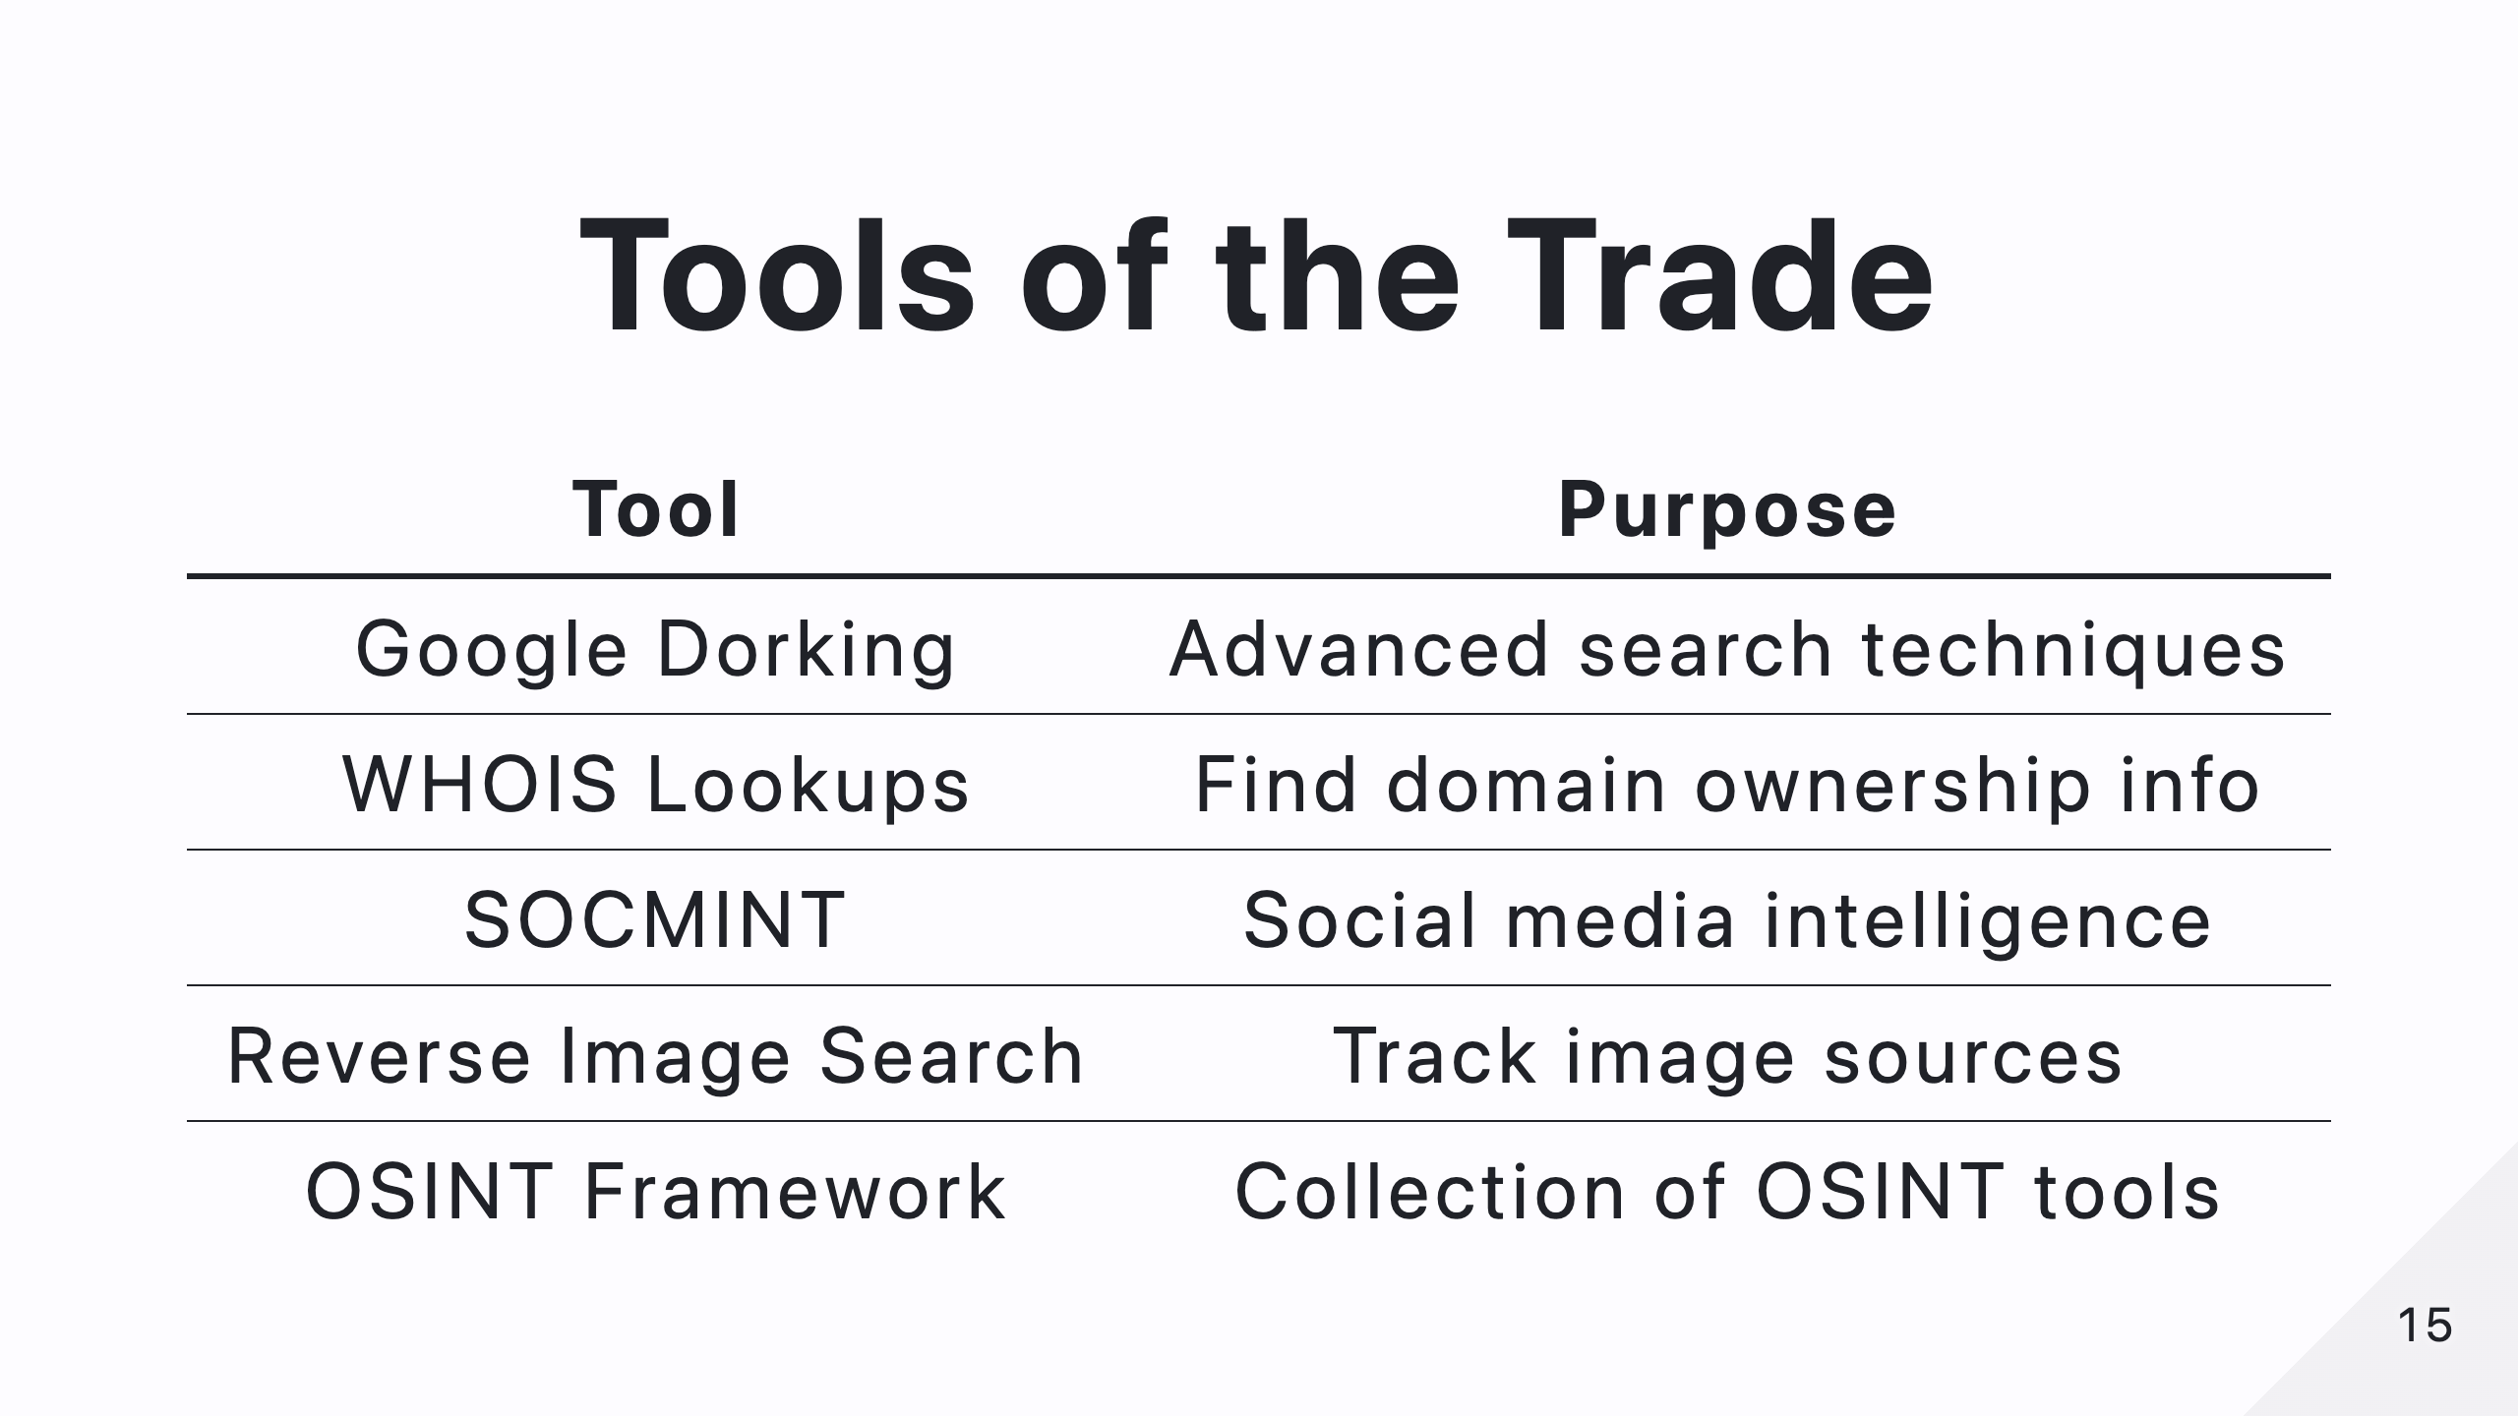
Notes:
To be effective in OSINT, you need the right tools. Google Dorking refines searches, WHOIS lookups reveal domain ownership, SOCMINT helps with social media intelligence, and reverse image search tracks where an image has appeared. OSINT Framework is a great collection of tools to explore.

Slide 16
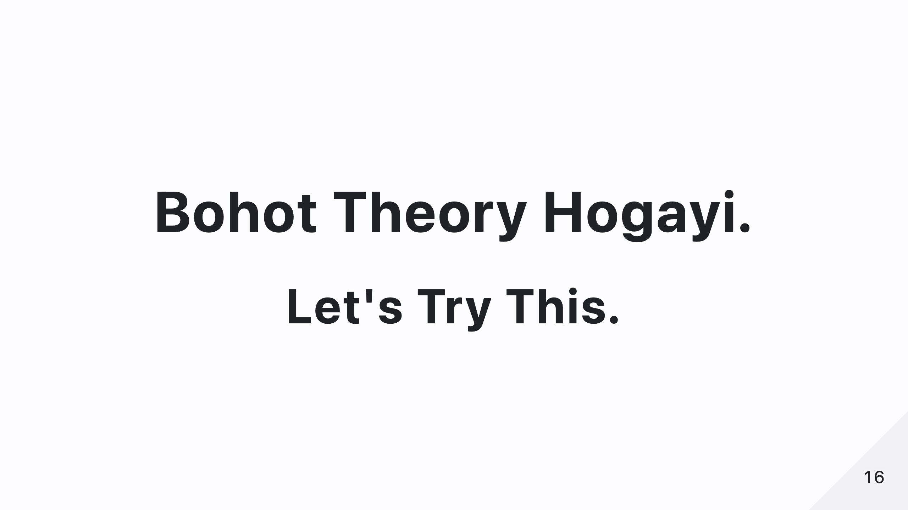
Notes:
Let’s stop talking and start doing! We’ll go hands-on with some OSINT techniques now.

Slide 17
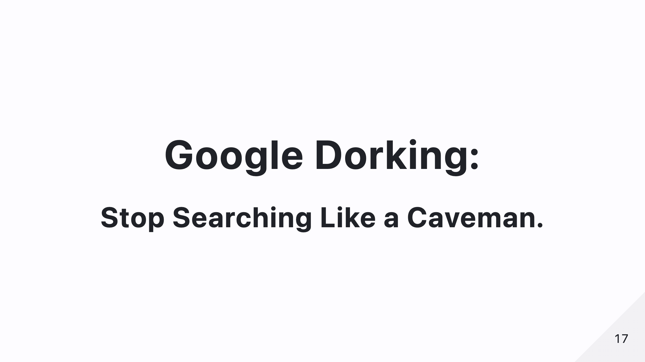
Notes:
Most people don’t know how to use Google properly. Google Dorking is an advanced way of searching that can help you find hidden files, sensitive information, and even login pages. Let’s try a few queries and see what we find!
site:
filetype:
intitle: “index of” -> open directory listings
Cameras : inurl:/view.shtml
inurl:"webcamXP"

Slide 18
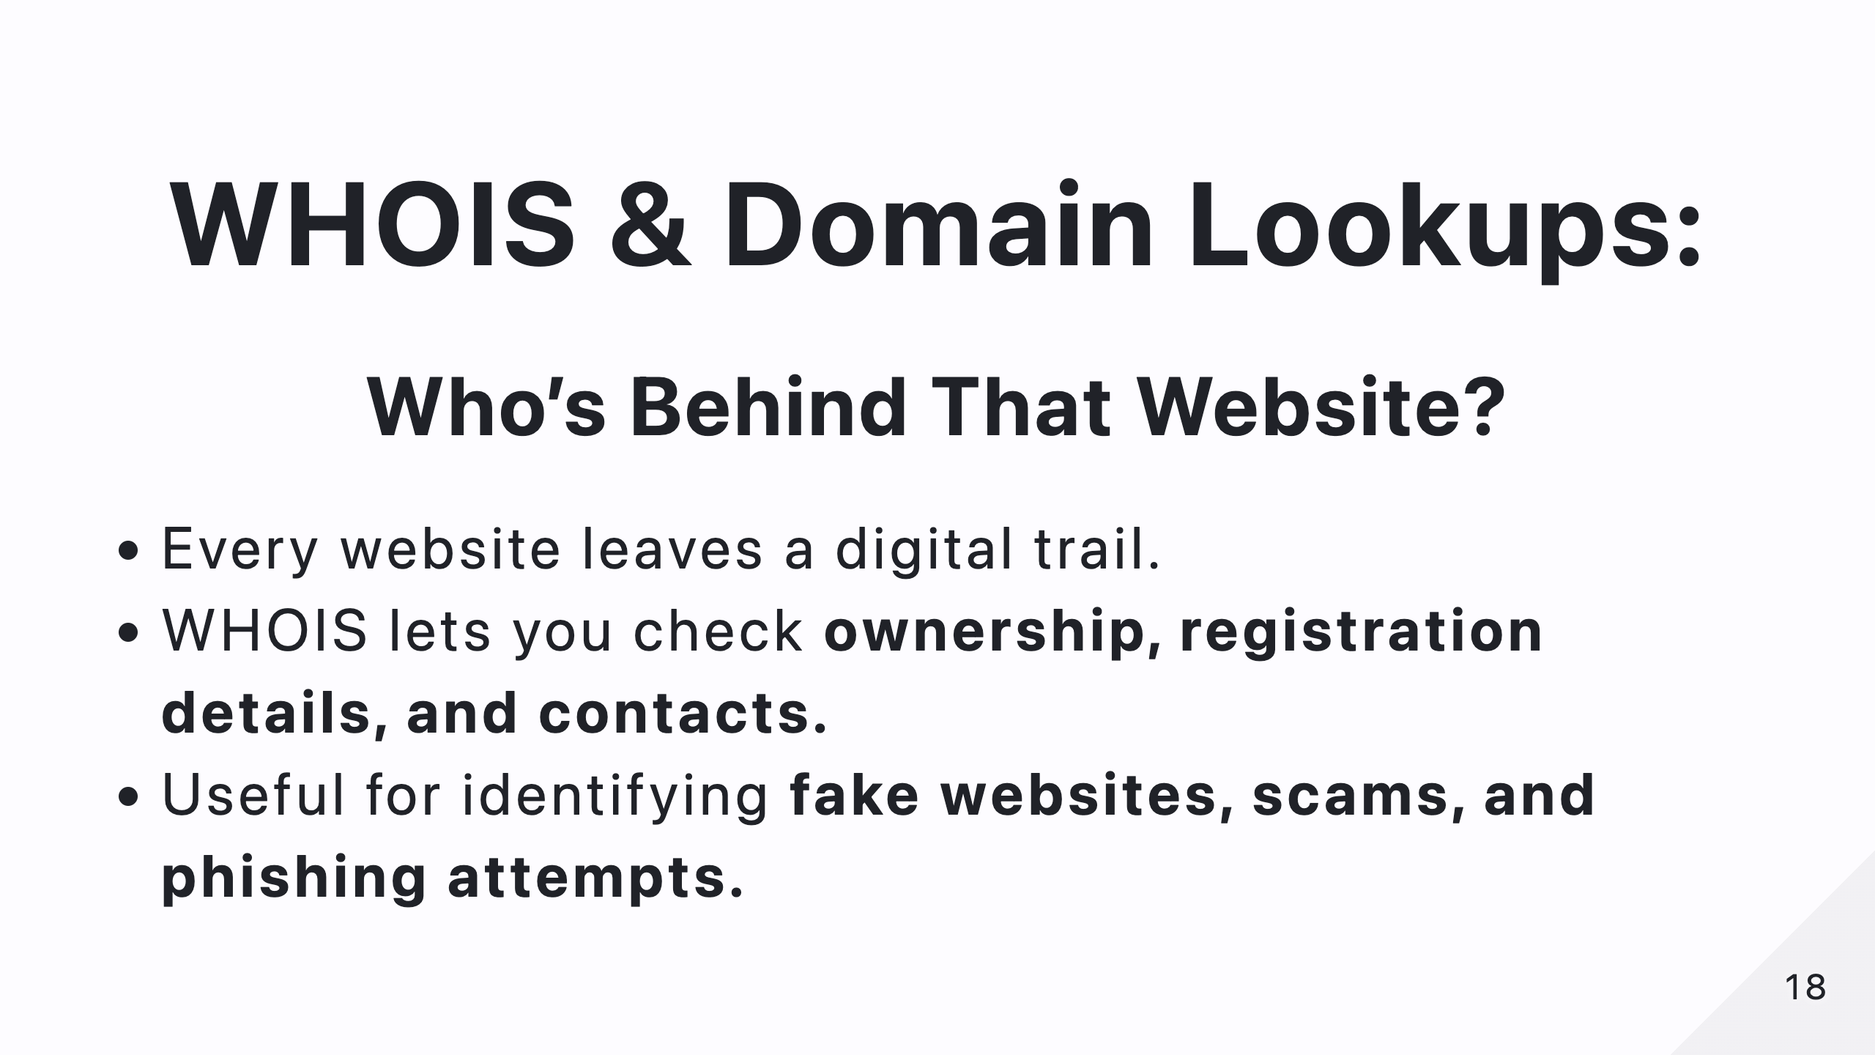
Notes:
Every website has an owner. WHOIS lookups let you see who registered a domain, when it was created, and where it's hosted. This is useful for identifying fake websites, scams, and phishing attempts.

Slide 19
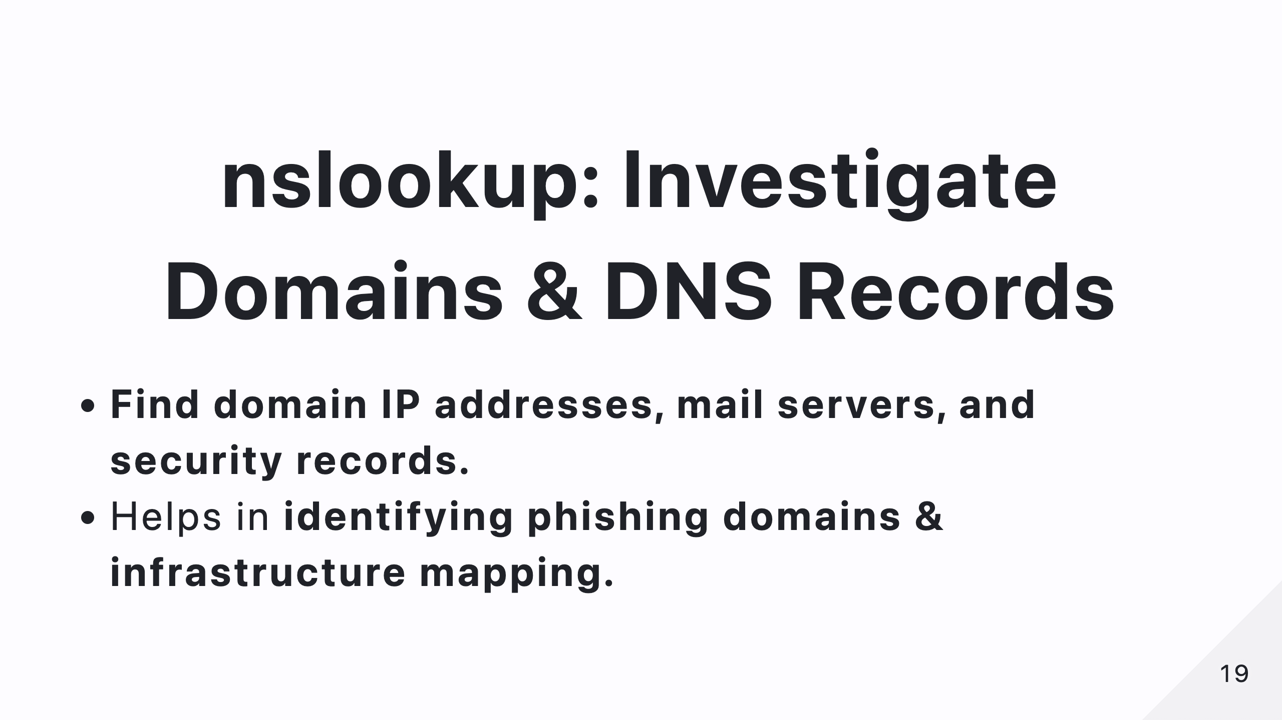
Notes:
Want to know more about a website? nslookup helps you find a domain’s IP address, mail servers, and security records. This is useful for mapping an organization’s online presence.

Slide 20
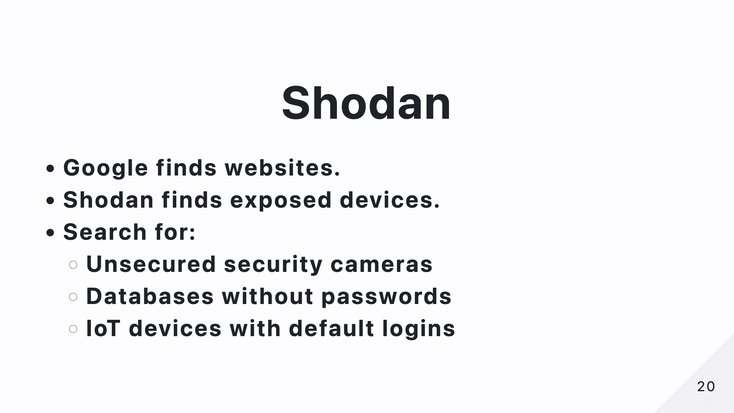
Notes:
Google finds websites, but Shodan finds devices connected to the internet. You’d be surprised how many security cameras, databases, and IoT devices are publicly exposed. This tool is a goldmine for cybersecurity professionals—and a nightmare for people who don’t secure their systems.

Slide 21
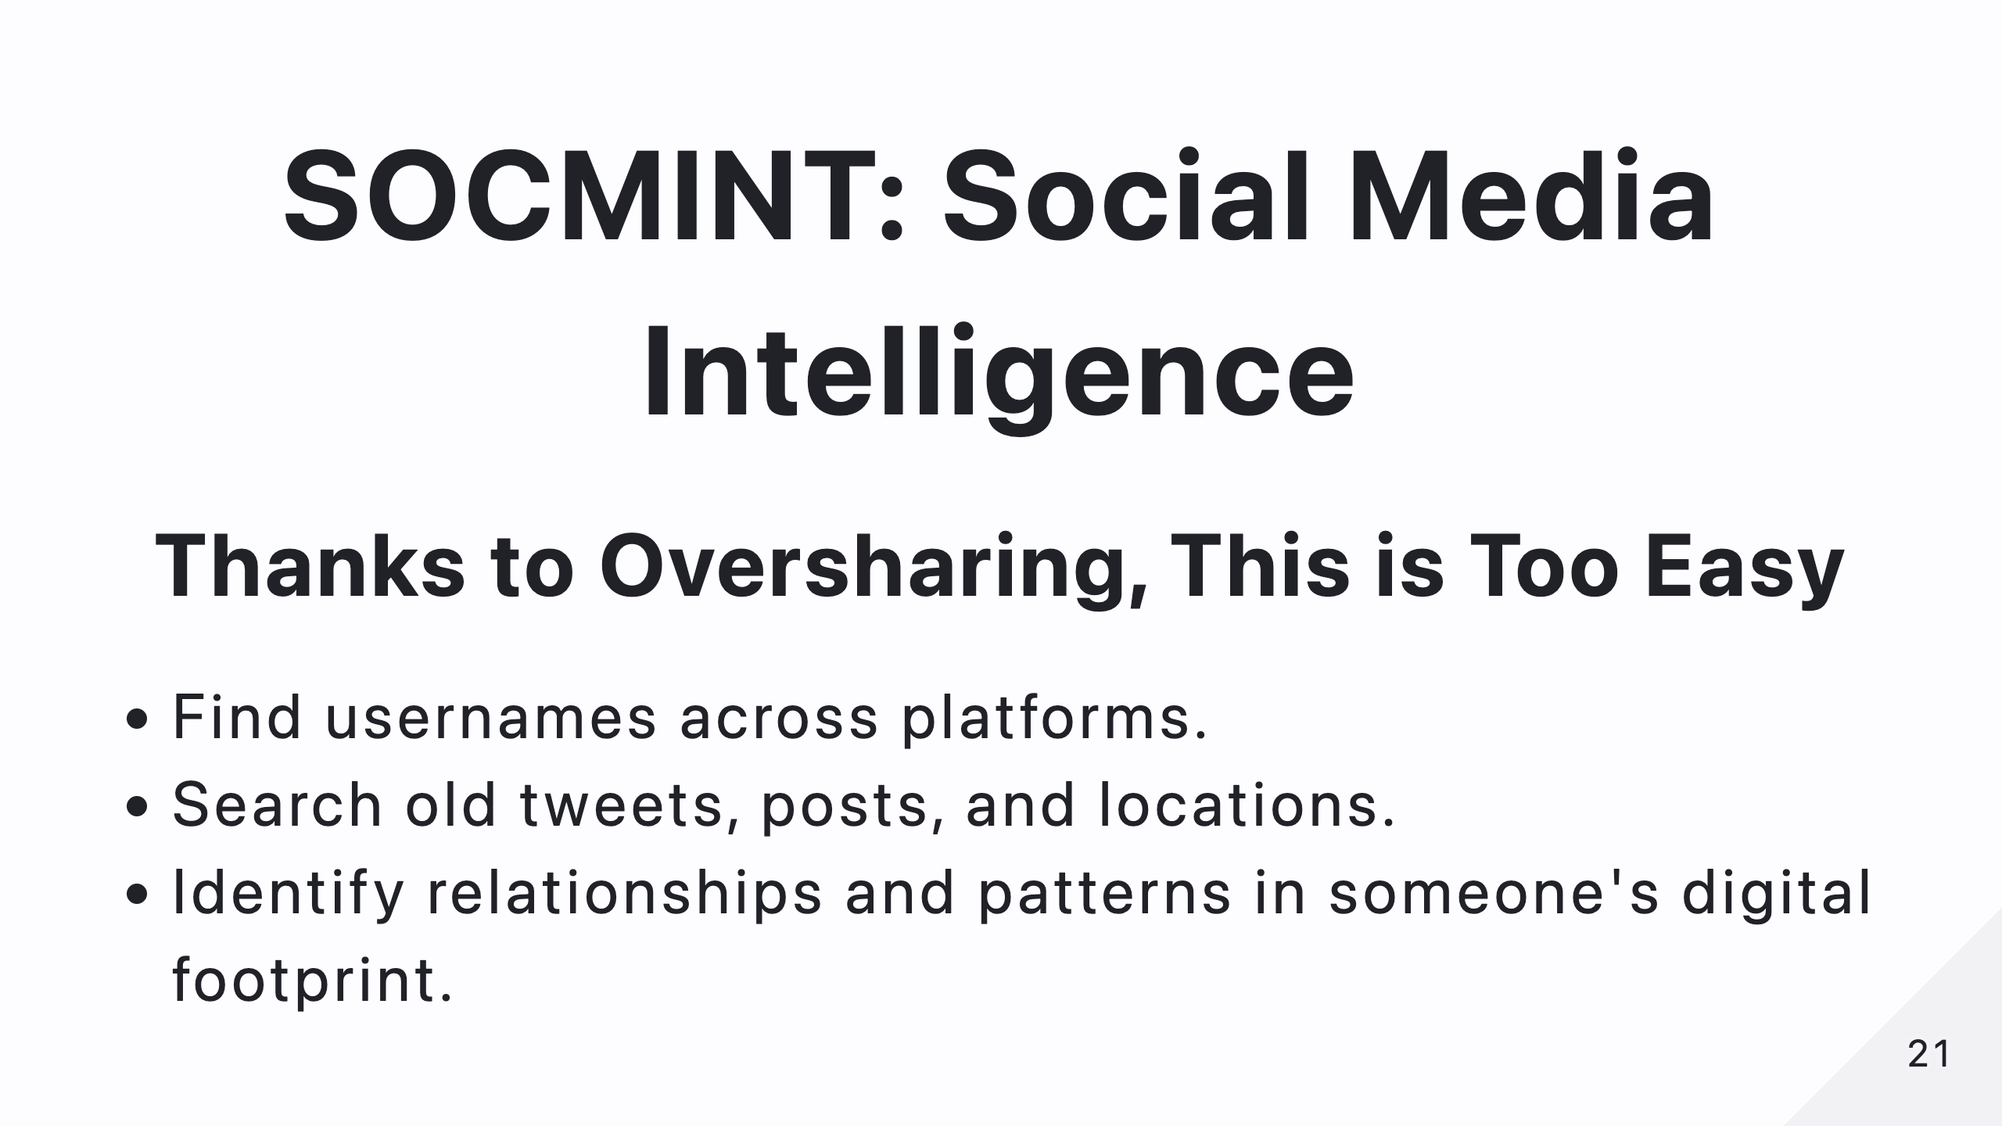
Notes:
Thanks to oversharing, gathering intelligence from social media is ridiculously easy. Usernames, old posts, locations—everything is out there if you know where to look.

Slide 22
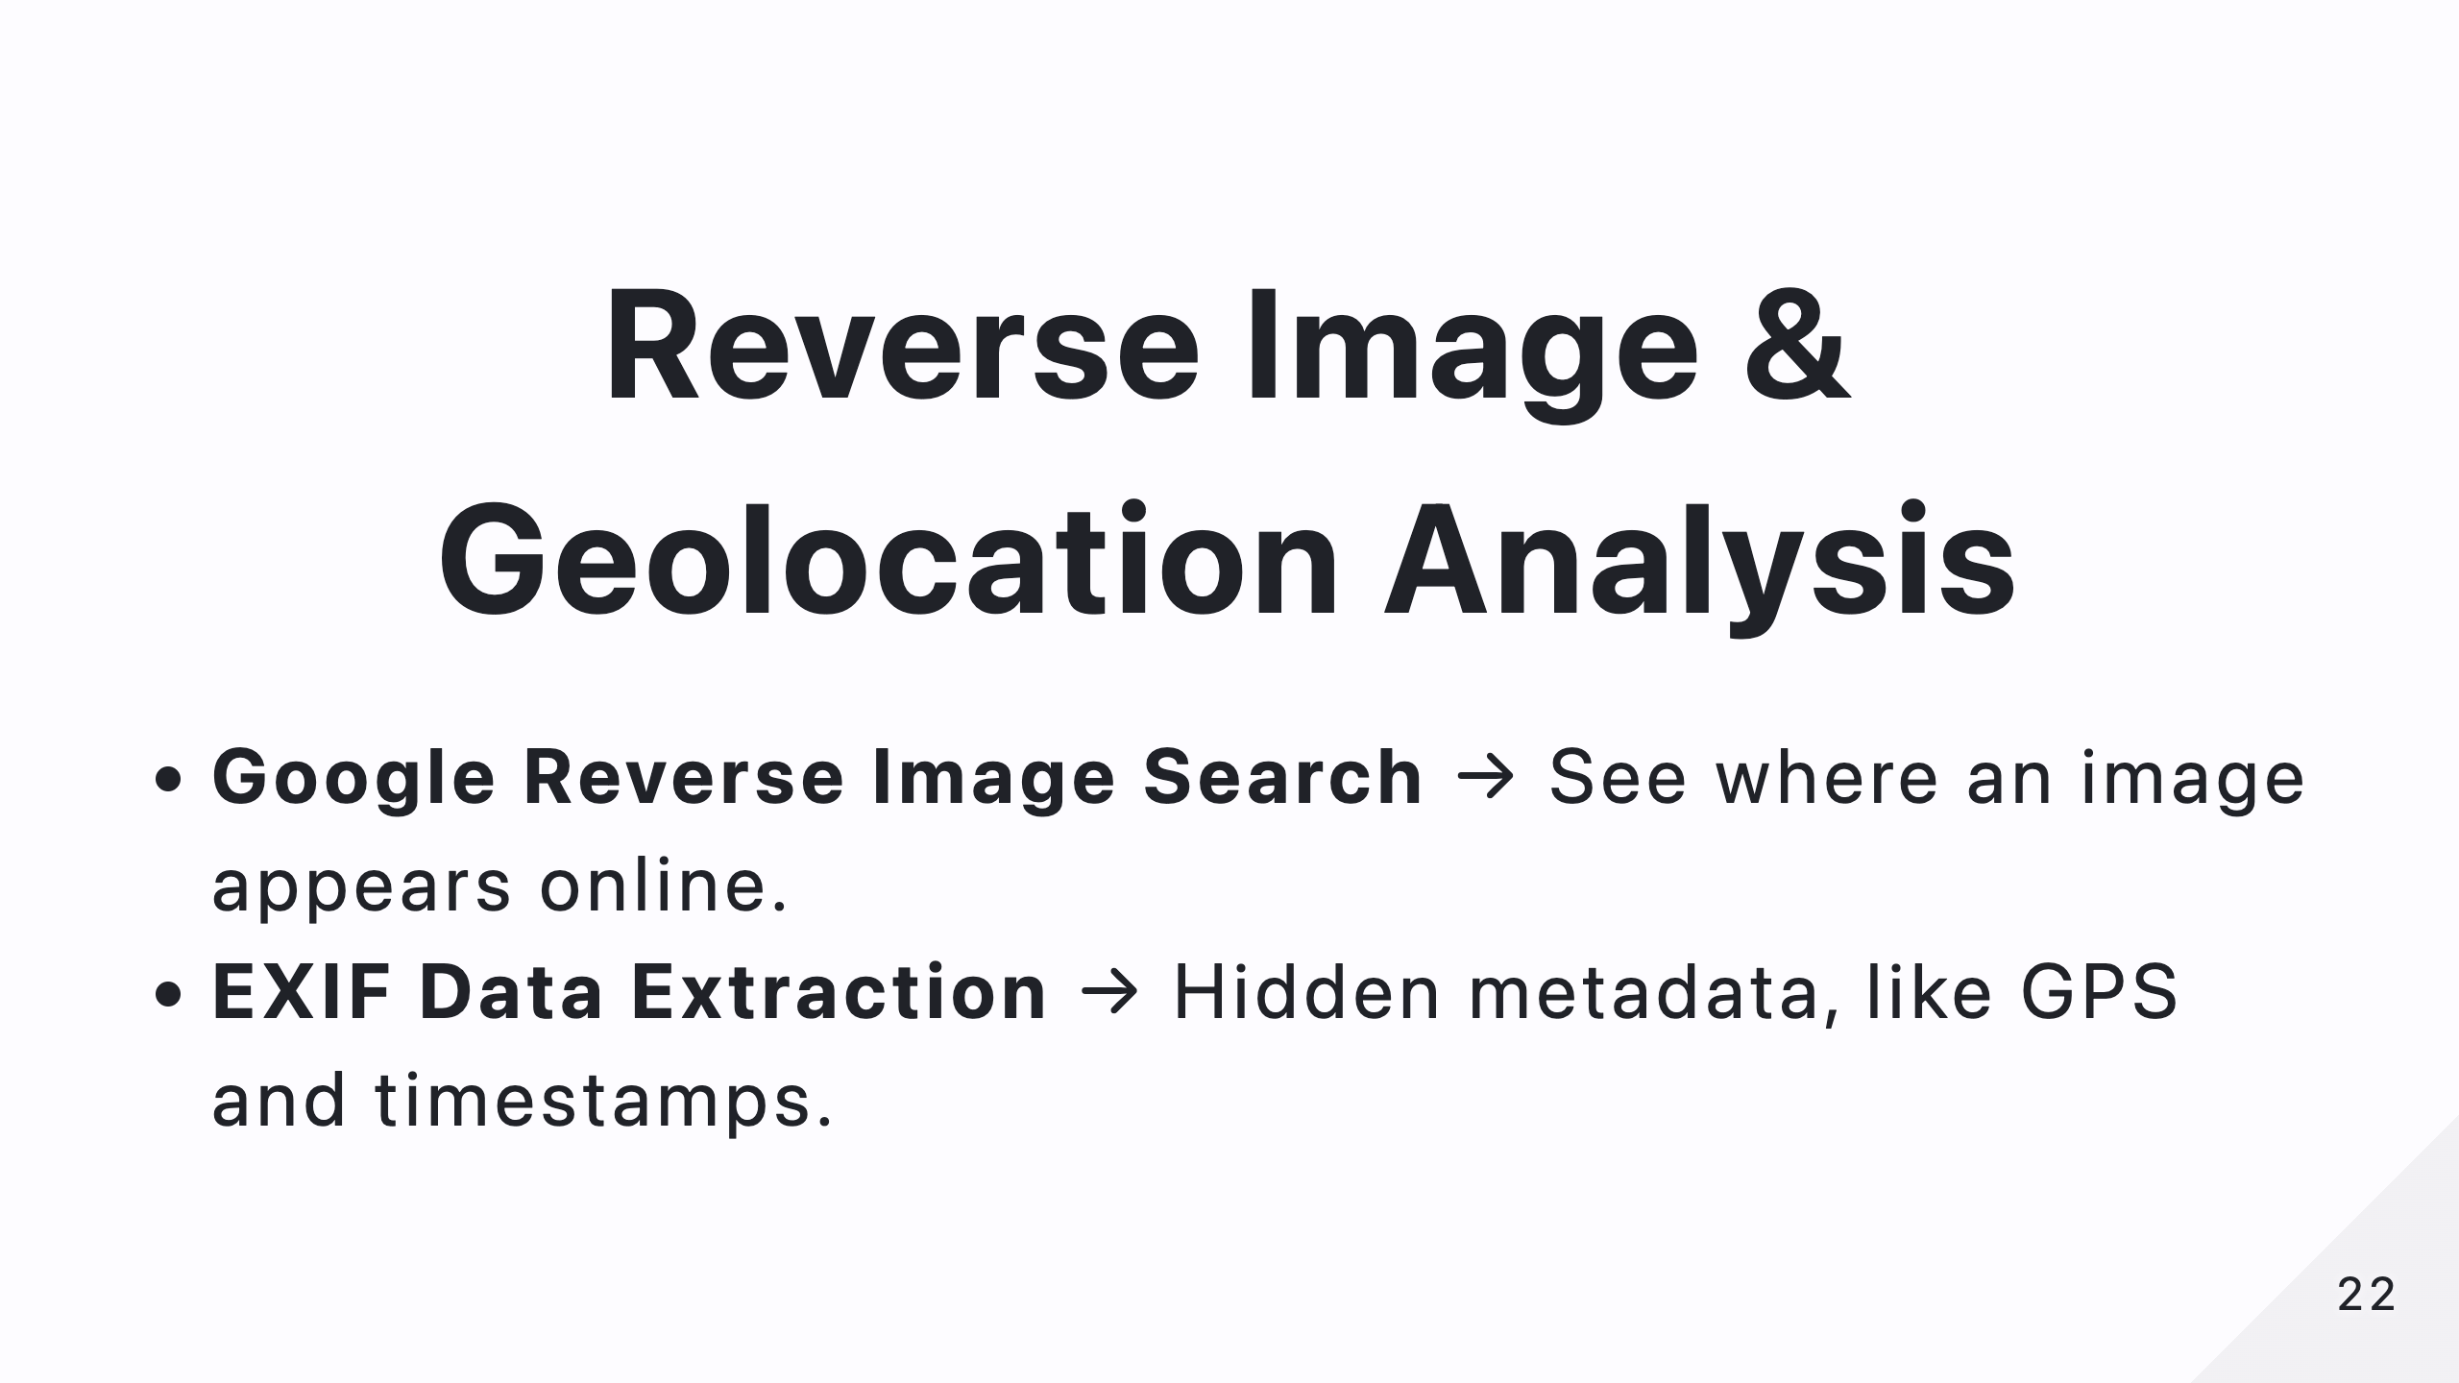
Notes:
Ever found an image and wondered where it came from? Reverse image search can tell you where it has appeared online. And if the image contains metadata, you might even get GPS coordinates and timestamps!
GPS data
Timestamps
Camera Info
Software

Slide 23
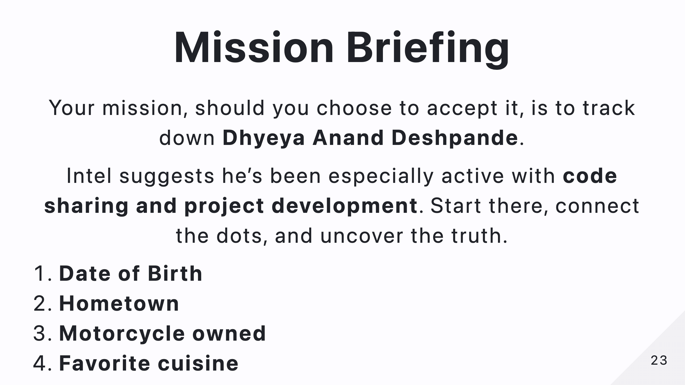
Notes:
Alright, it’s time for a live challenge! Your mission, should you choose to accept it, is to track down Dhyeya Anand Deshpande. He’s been active in code sharing and project development. Using OSINT techniques, find these details about him: Date of Birth, Hometown, Motorcycle owned, and Favorite cuisine. Good luck, agents!

Slide 24
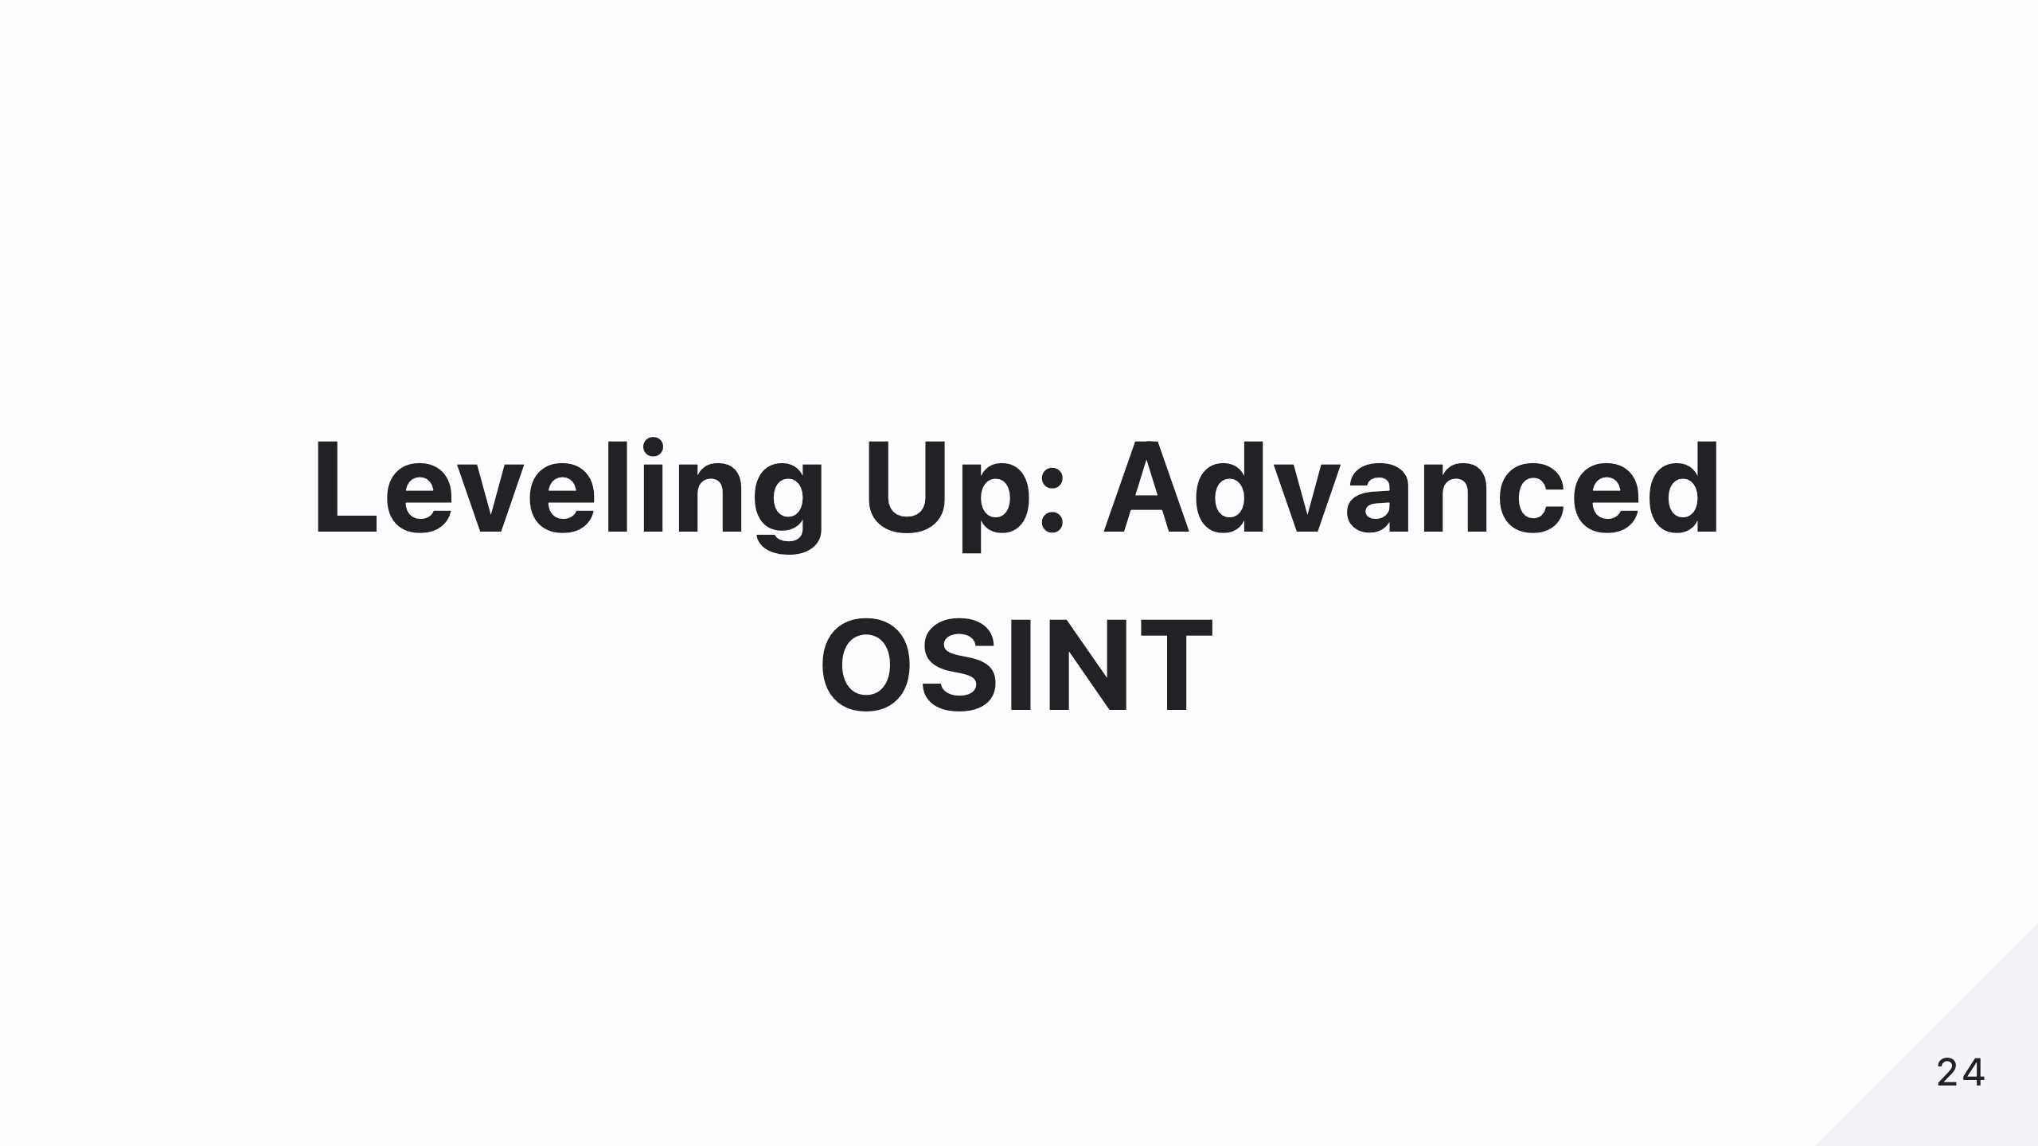
Notes:
Now that you have the basics down, let’s explore more advanced OSINT tools.

Slide 25
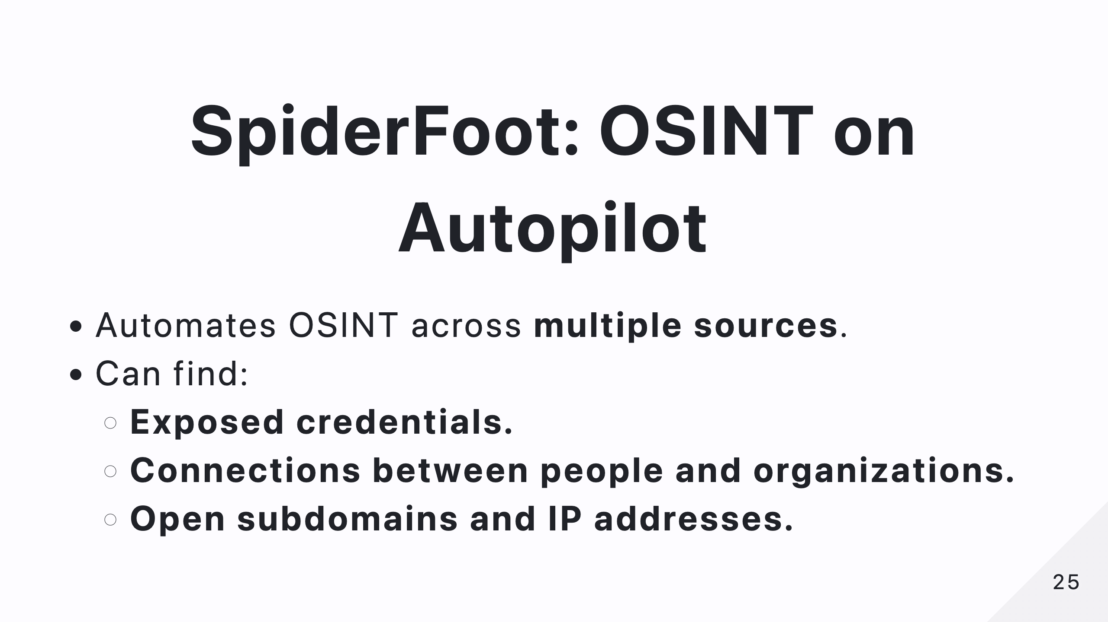
Notes:
SpiderFoot automates OSINT, scanning multiple sources at once to find exposed credentials, connections, and subdomains. If you want to save time, this tool is your best friend.

Slide 26
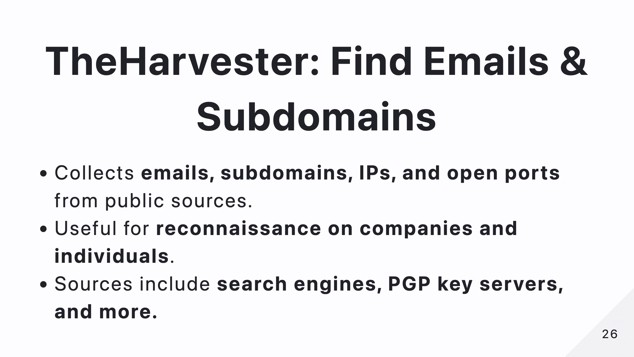
Notes:
TheHarvester is a powerful tool for finding emails, subdomains, and IPs. It scrapes information from search engines, PGP key servers, and more—perfect for reconnaissance.
Google Emails, hosts, subdomains
Bing Subdomains, emails
Crtsh SSL certificate subdomains
Hackertarget Subdomains, hostnames
Shodan Open ports, vulnerabilities (API key required)
Virustotal Hosts, subdomains (API key required)

Slide 27
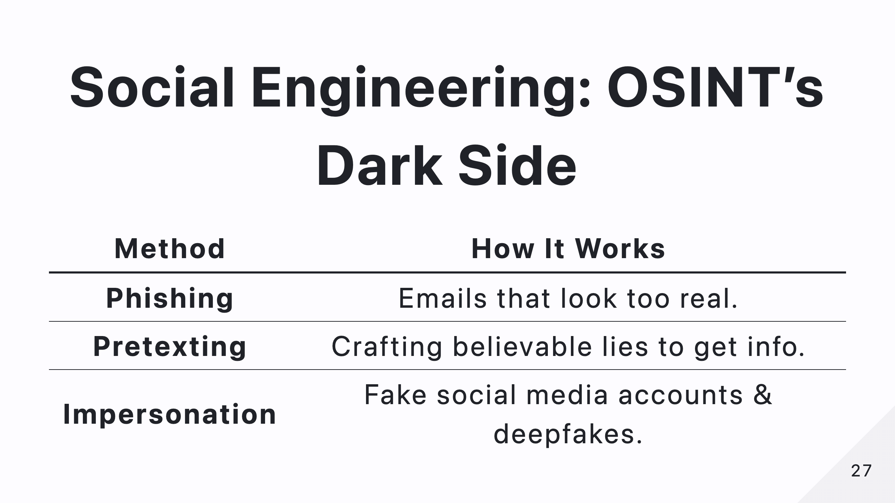
Notes:
OSINT isn’t just about data—it’s also about human psychology. Social engineering exploits trust to manipulate people into revealing information. Phishing, pretexting, and impersonation are common tactics.

Slide 28
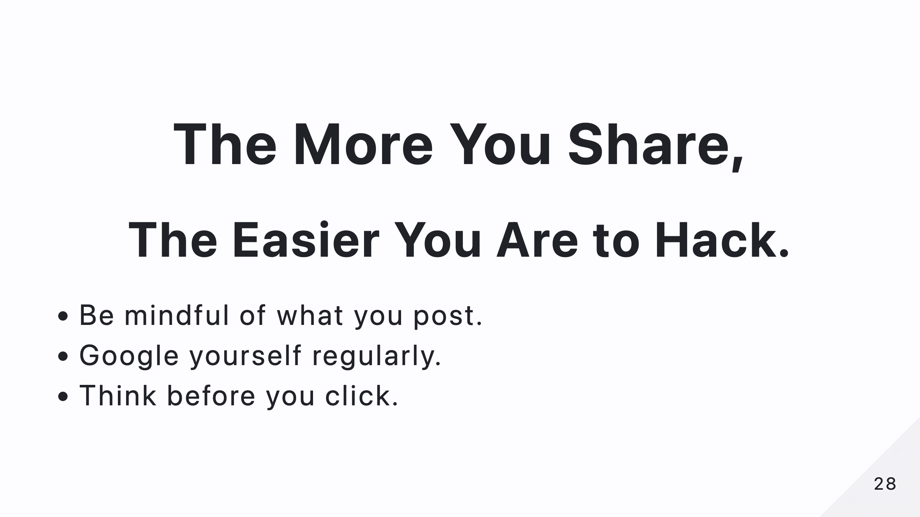
Notes:
This is why OPSEC—Operational Security—is crucial. Be mindful of what you share online, Google yourself regularly, and think before you click on anything suspicious.

Slide 29
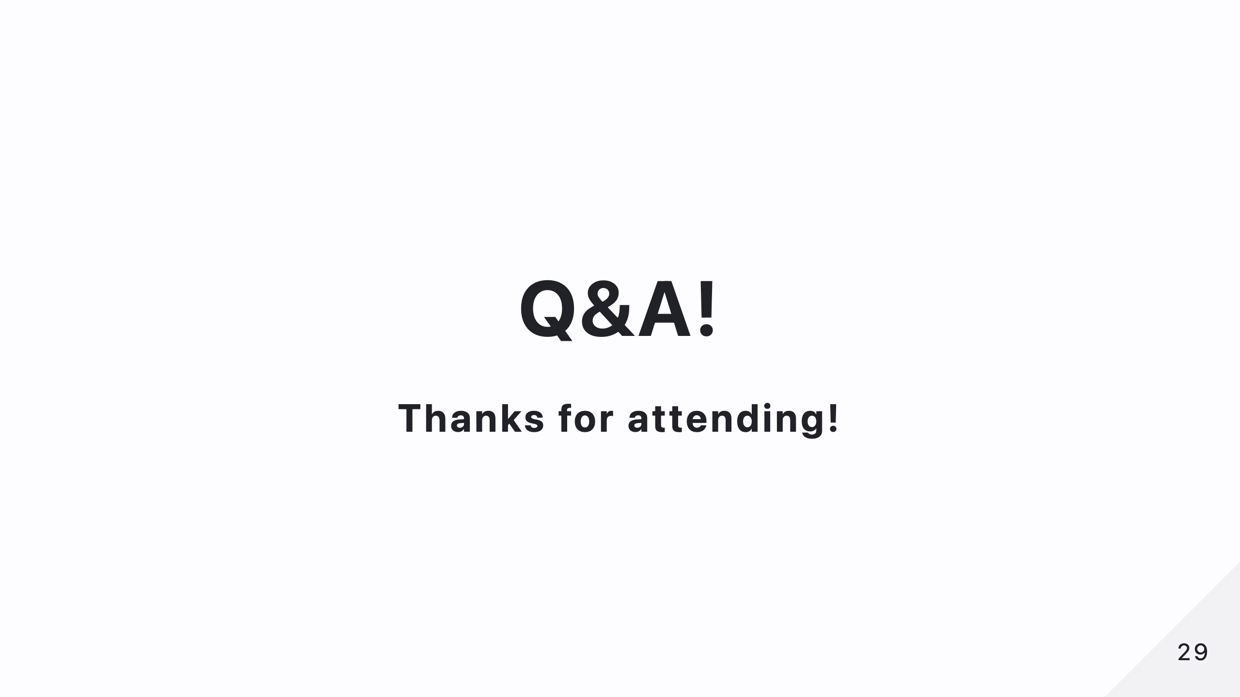
Notes:
That’s it for today! Thank you for attending, and I hope you learned something valuable. If you have any questions, now’s the time!

